Slide 1

Welcome to the presentation on “Leadership Styles”

Slide 2
A leader is one who inspires, motivates and leads people to accomplish organizational goals

Slide 3

Leadership is all about influencing a group of people

Slide 4
Characteristics of effective leader

Slide 5
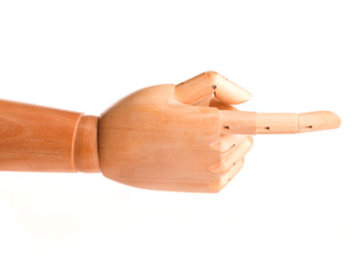
Take the challenges to grow

Slide 6

Take calculated risks

Slide 7

Adopt the leadership style that fits you and your personality

Slide 8

Have courage at the time of controversies

Slide 9

Accept their mistakes

Slide 10
Communicate frequently

Slide 11
Be approachable

Slide 12

Understand the situation and the fact

Slide 13
Essential requisites of leadership are

Slide 14

Trust

Slide 15

Collaboration

Slide 16

Confidence

Slide 17

Competence

Slide 18

Competitive Spirit

Slide 19
How do you define leadership style?

Slide 20

Types of Leadership Styles

Slide 21

1. Democratic/ Participative Leadership Style

Slide 22

When to use Democratic Leadership Style?

Slide 23

Team Agreement is needed

Slide 24
Greater motivation and commitment

Slide 25
Knowledgeable and skillful team members

Slide 26

Limitation of Democratic Leadership Style

Slide 27
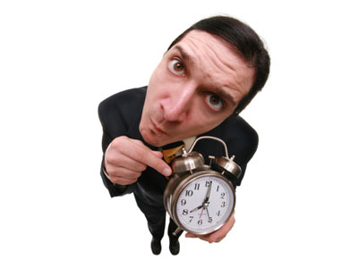
It is a time consuming affair

Slide 28

2. Autocratic Leadership Style

Slide 29

When to use Autocratic Leadership Style?

Slide 30

When quick decisions are needed

Slide 31

No need for others input

Slide 32

Team agreement is not necessary

Slide 33
When high level of management control is needed

Slide 34

Limitations of Autocratic Leadership

Slide 35

Employees cannot question decisions

Slide 36

Little opportunity to give suggestions

Slide 37

3. Laissez-Faire/ Free Rein Leadership Style

Slide 38

When to use Laissez Faire/ Free Rein Style?

Slide 39

When the team is highly capable

Slide 40
When team members are able to analyze the situation

Slide 41

When close monitoring of a decision is not needed

Slide 42
When there is full trust and confidence in the team members

Slide 43

Limitations of Laissez Faire/ Free Rein Leadership Style

Slide 44

Not suitable for lesser experienced employees

Slide 45
Lack of motivation

Slide 46
Poor productivity

Slide 47

What are the factors for selecting leadership style?

Slide 48

Objectives that need to be achieved

Slide 49

Followers

Slide 50

Situation

Slide 51

Apply the appropriate leadership style and techniques

Slide 52
Leadership style is the approach for providing the right way to the team members, implementing planning strategies and motivating people by including all the three leadership styles.

Slide 53
Effective leadership is not about making speeches or being liked; leadership is defined by results not attributes.
Peter Drucker

Slide 54
To read articles on similar topics, please visit:
blog.commlabindia.com

Slide 55
Thank You

